Slide 1
Auction Platform
Mehmet Ali Altunsoy
Gökberk Boz
Gizem Karal
Irmak Çeliker

Slide 2
Agenda Style
01
General Information about the Auction Platform
02
Graphical User Interface
03
Detailed Design
04
DEMO

Slide 3
General Information

Slide 4
What is Auction Platform?
What is it?
Auction Platform is an application which lets people to shop online by the help of the auction method. It puts another perspective into online shopping by enabling sellers to perform auction between the buyers. By bidding higher amounts for the products buyers can buy them until the auction time is finished.

Slide 5
Why to use it?
Benefits
By the help of this application, while sellers are able to sell their products, buyers are able to reach many different the products they are interested in.
How to use it
To buy the item, buyers must offer a price higher than the price determined by the sellers and until the auction is finished they must keep on offering.

Slide 6
Graphical User Interface

Slide 7
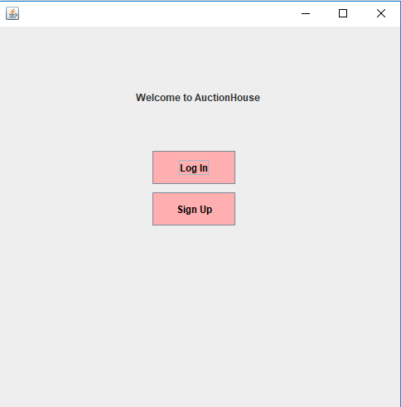
Welcome Page

Slide 8
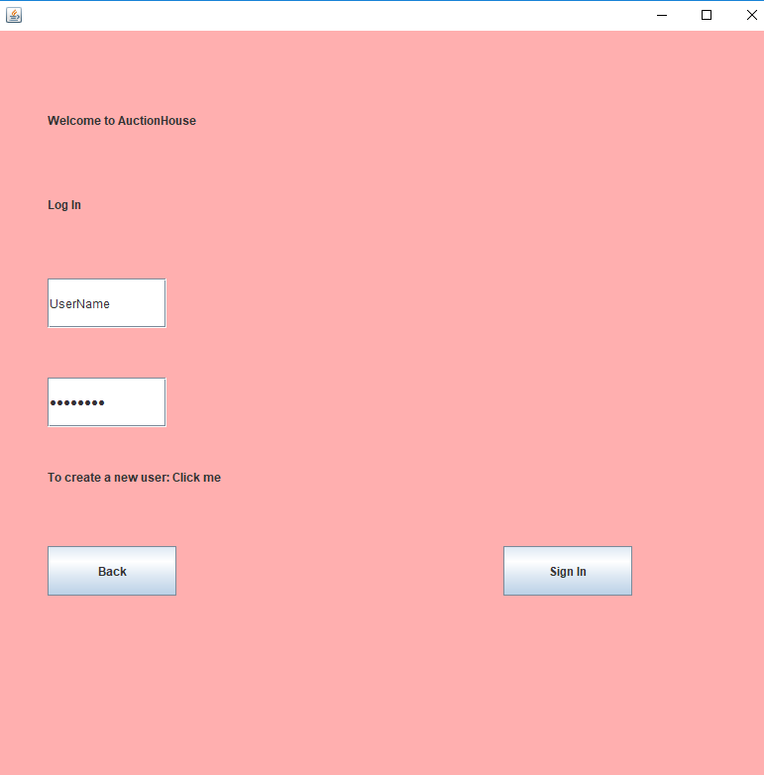
Login
Page

Slide 9
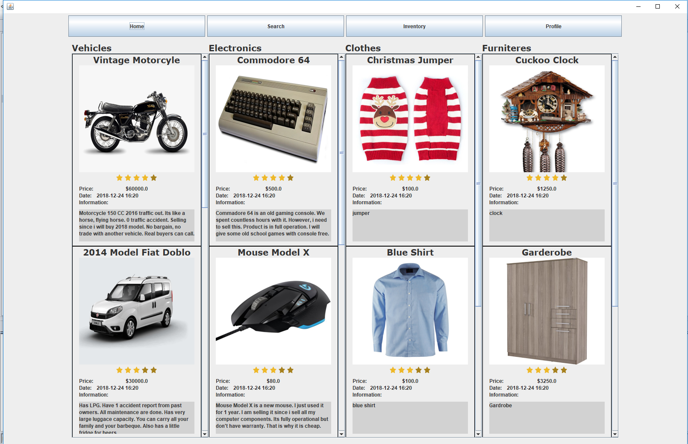
Home Panel

Slide 10
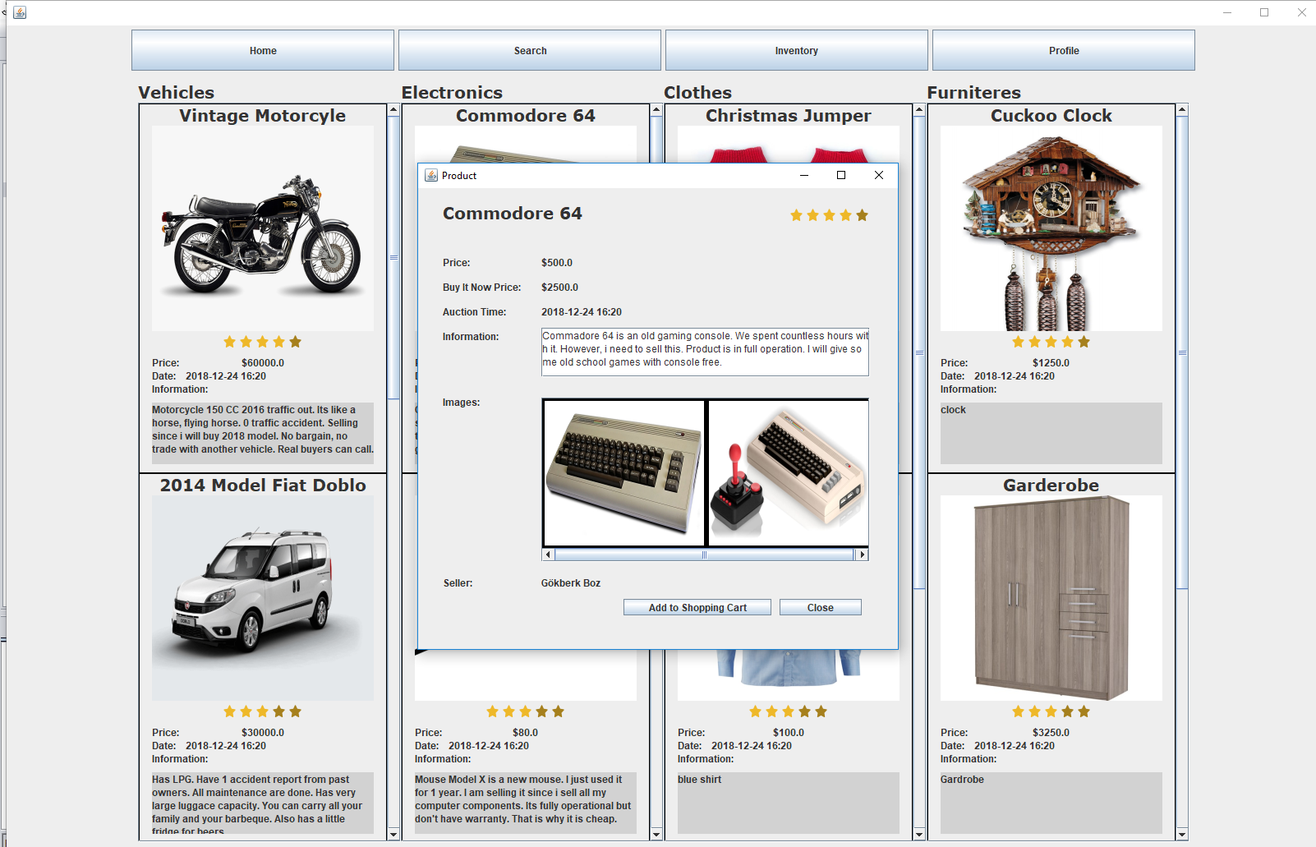
Display Product

Slide 11
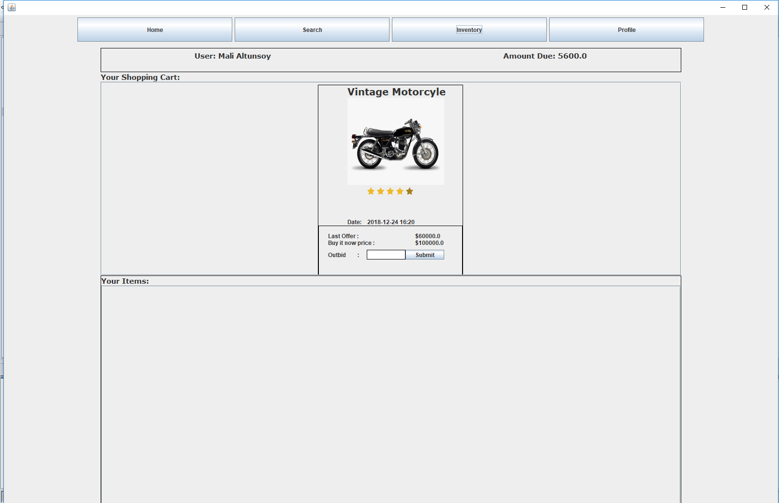
Shopping Cart

Slide 12
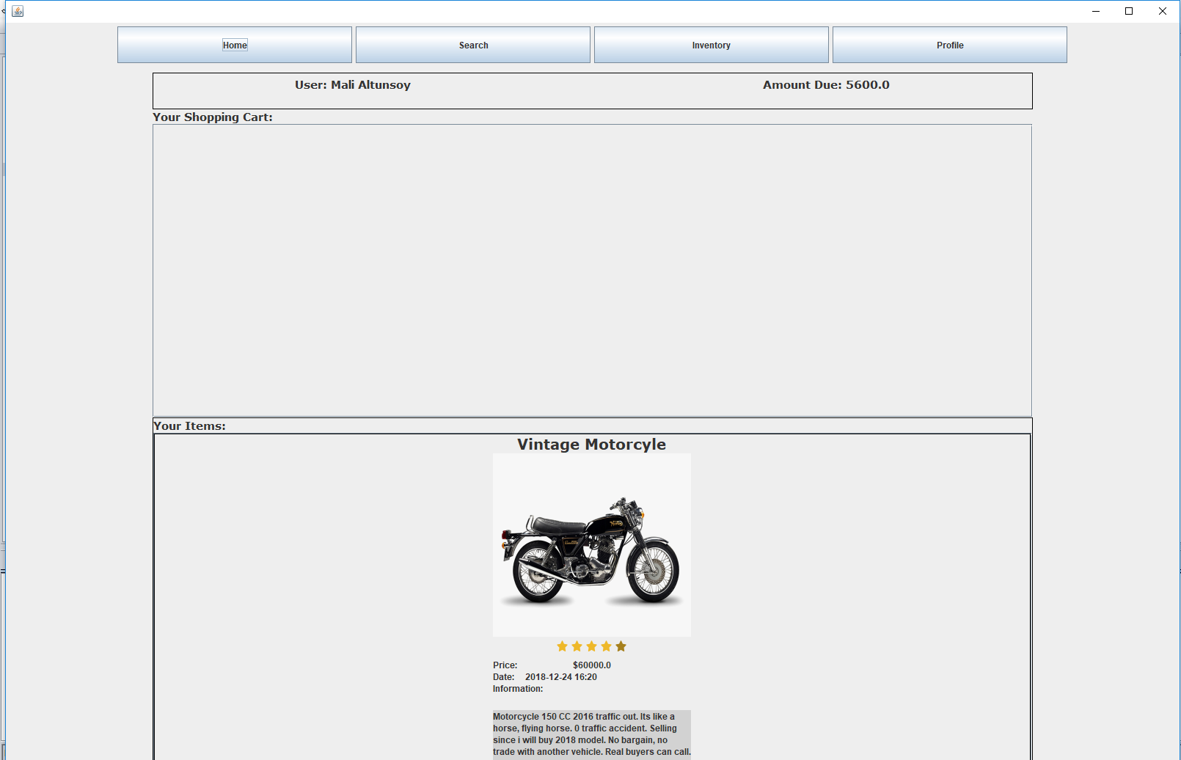
Your Items

Slide 13
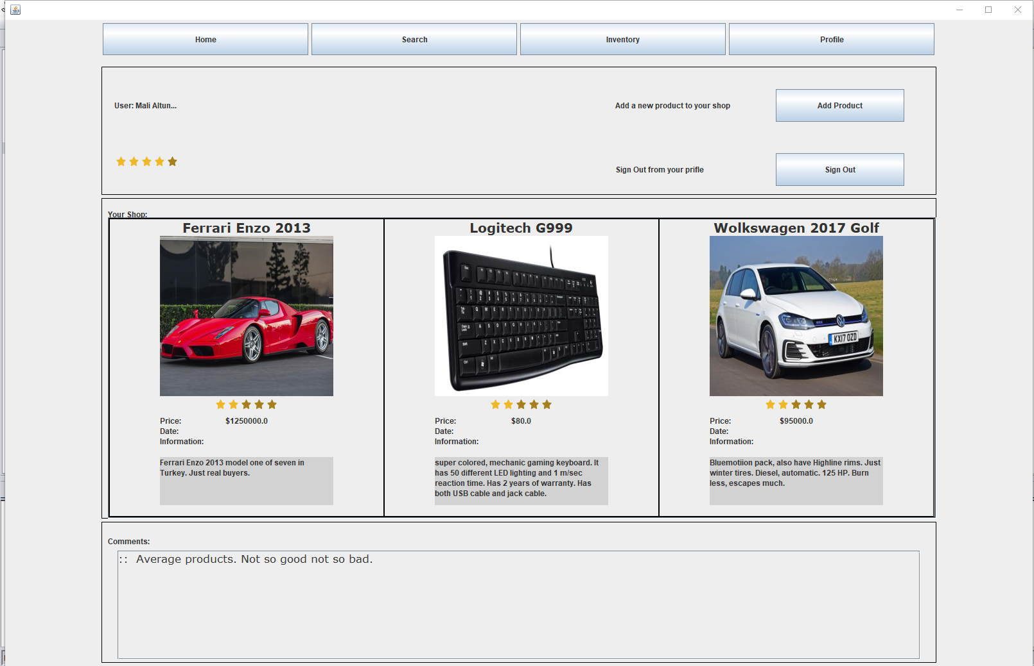
Your Shop

Slide 14
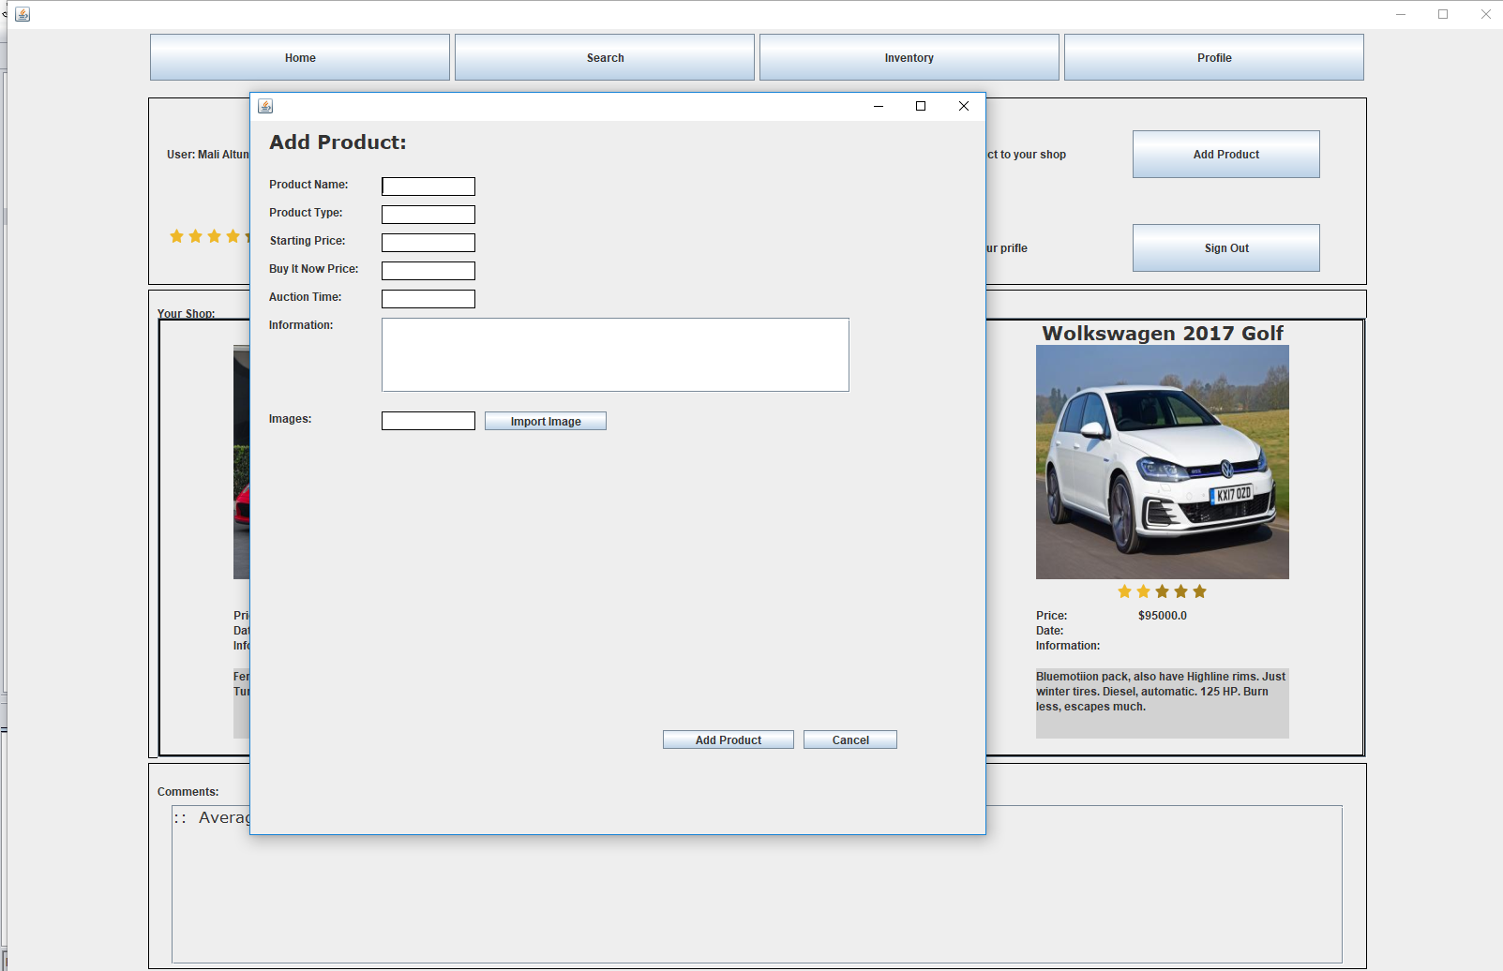
Add a Product

Slide 15
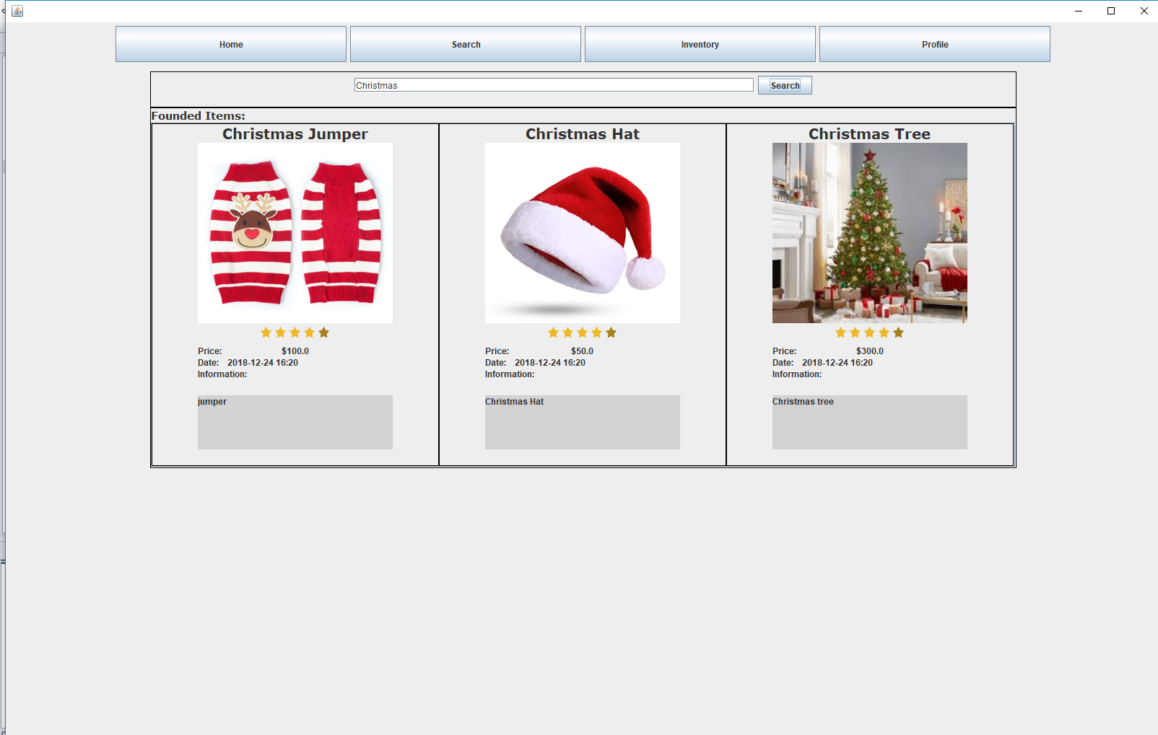
Search a Product

Slide 16
Detailed Design

Slide 17
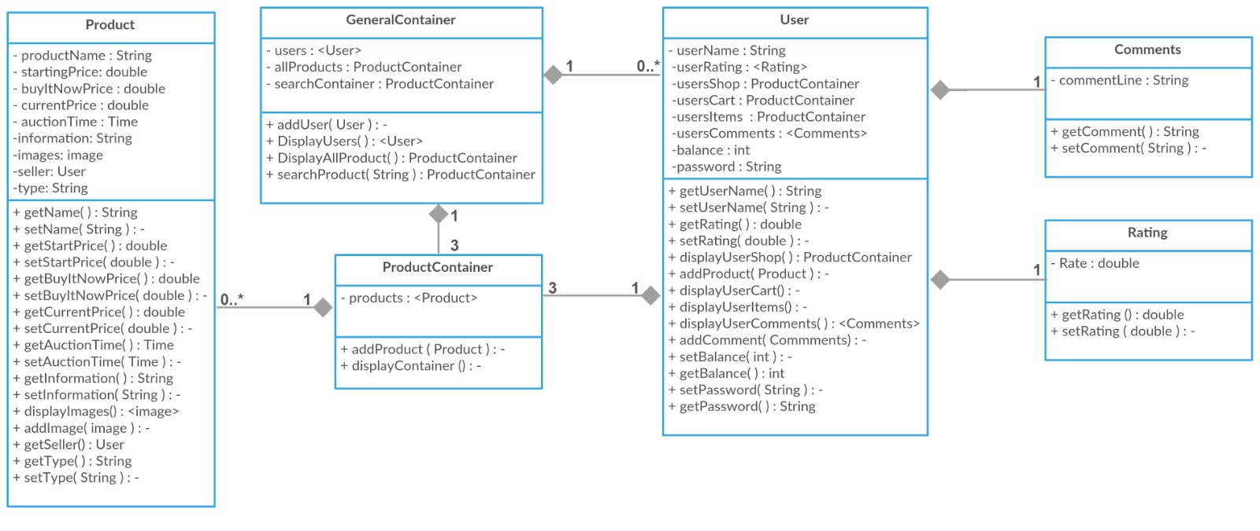
Detailed Design
Insert the title of your subtitle Here

Slide 18
DEMO

Slide 19
Thank you!

